Slide 2
3 Steps: Building the Ramp
Becky Pugmire, MSN, FNP-C
-Sentara Vascular Specialists
-EVMS Community Faculty – Physical Medicine and Rehab
Notes:
3 steps...odd name for a talk, but bear with me. I recently learned that majority of houses in the Hampton roads area are built on slab or on a crawl space with at least 3 steps required to enter a home.
How many of us climb those 3 steps every day to enter our home without thinking about it?
Now imagine trying to do it without a foot or a knee on 1 side.. (how many think you can still do it?)
This is just 1 challenge that amputees face, so how can we help build the ramp?

Slide 3
The 3 Domains
Emotional
Physical
Social
Notes:
To start building this ramp we need to take patient perspectives into mind . A qualitative systemic review of 15 papers regarding this was published in 2022 in the International Journal of Orthopaedic and Trauma Nursing. They found 6 main themes, I have grouped them into 3 domains.

Slide 4
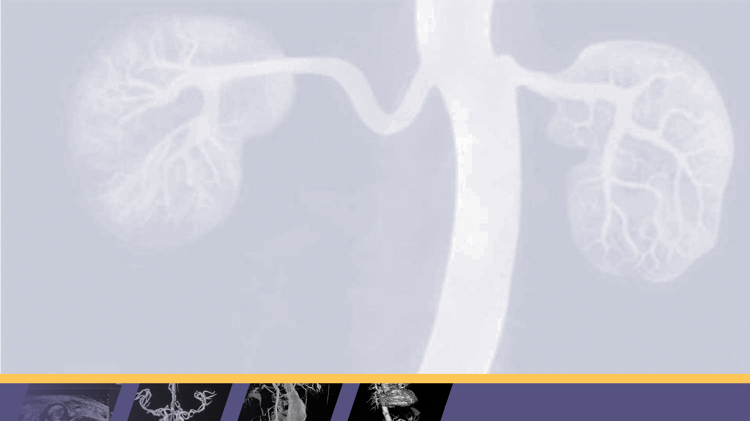
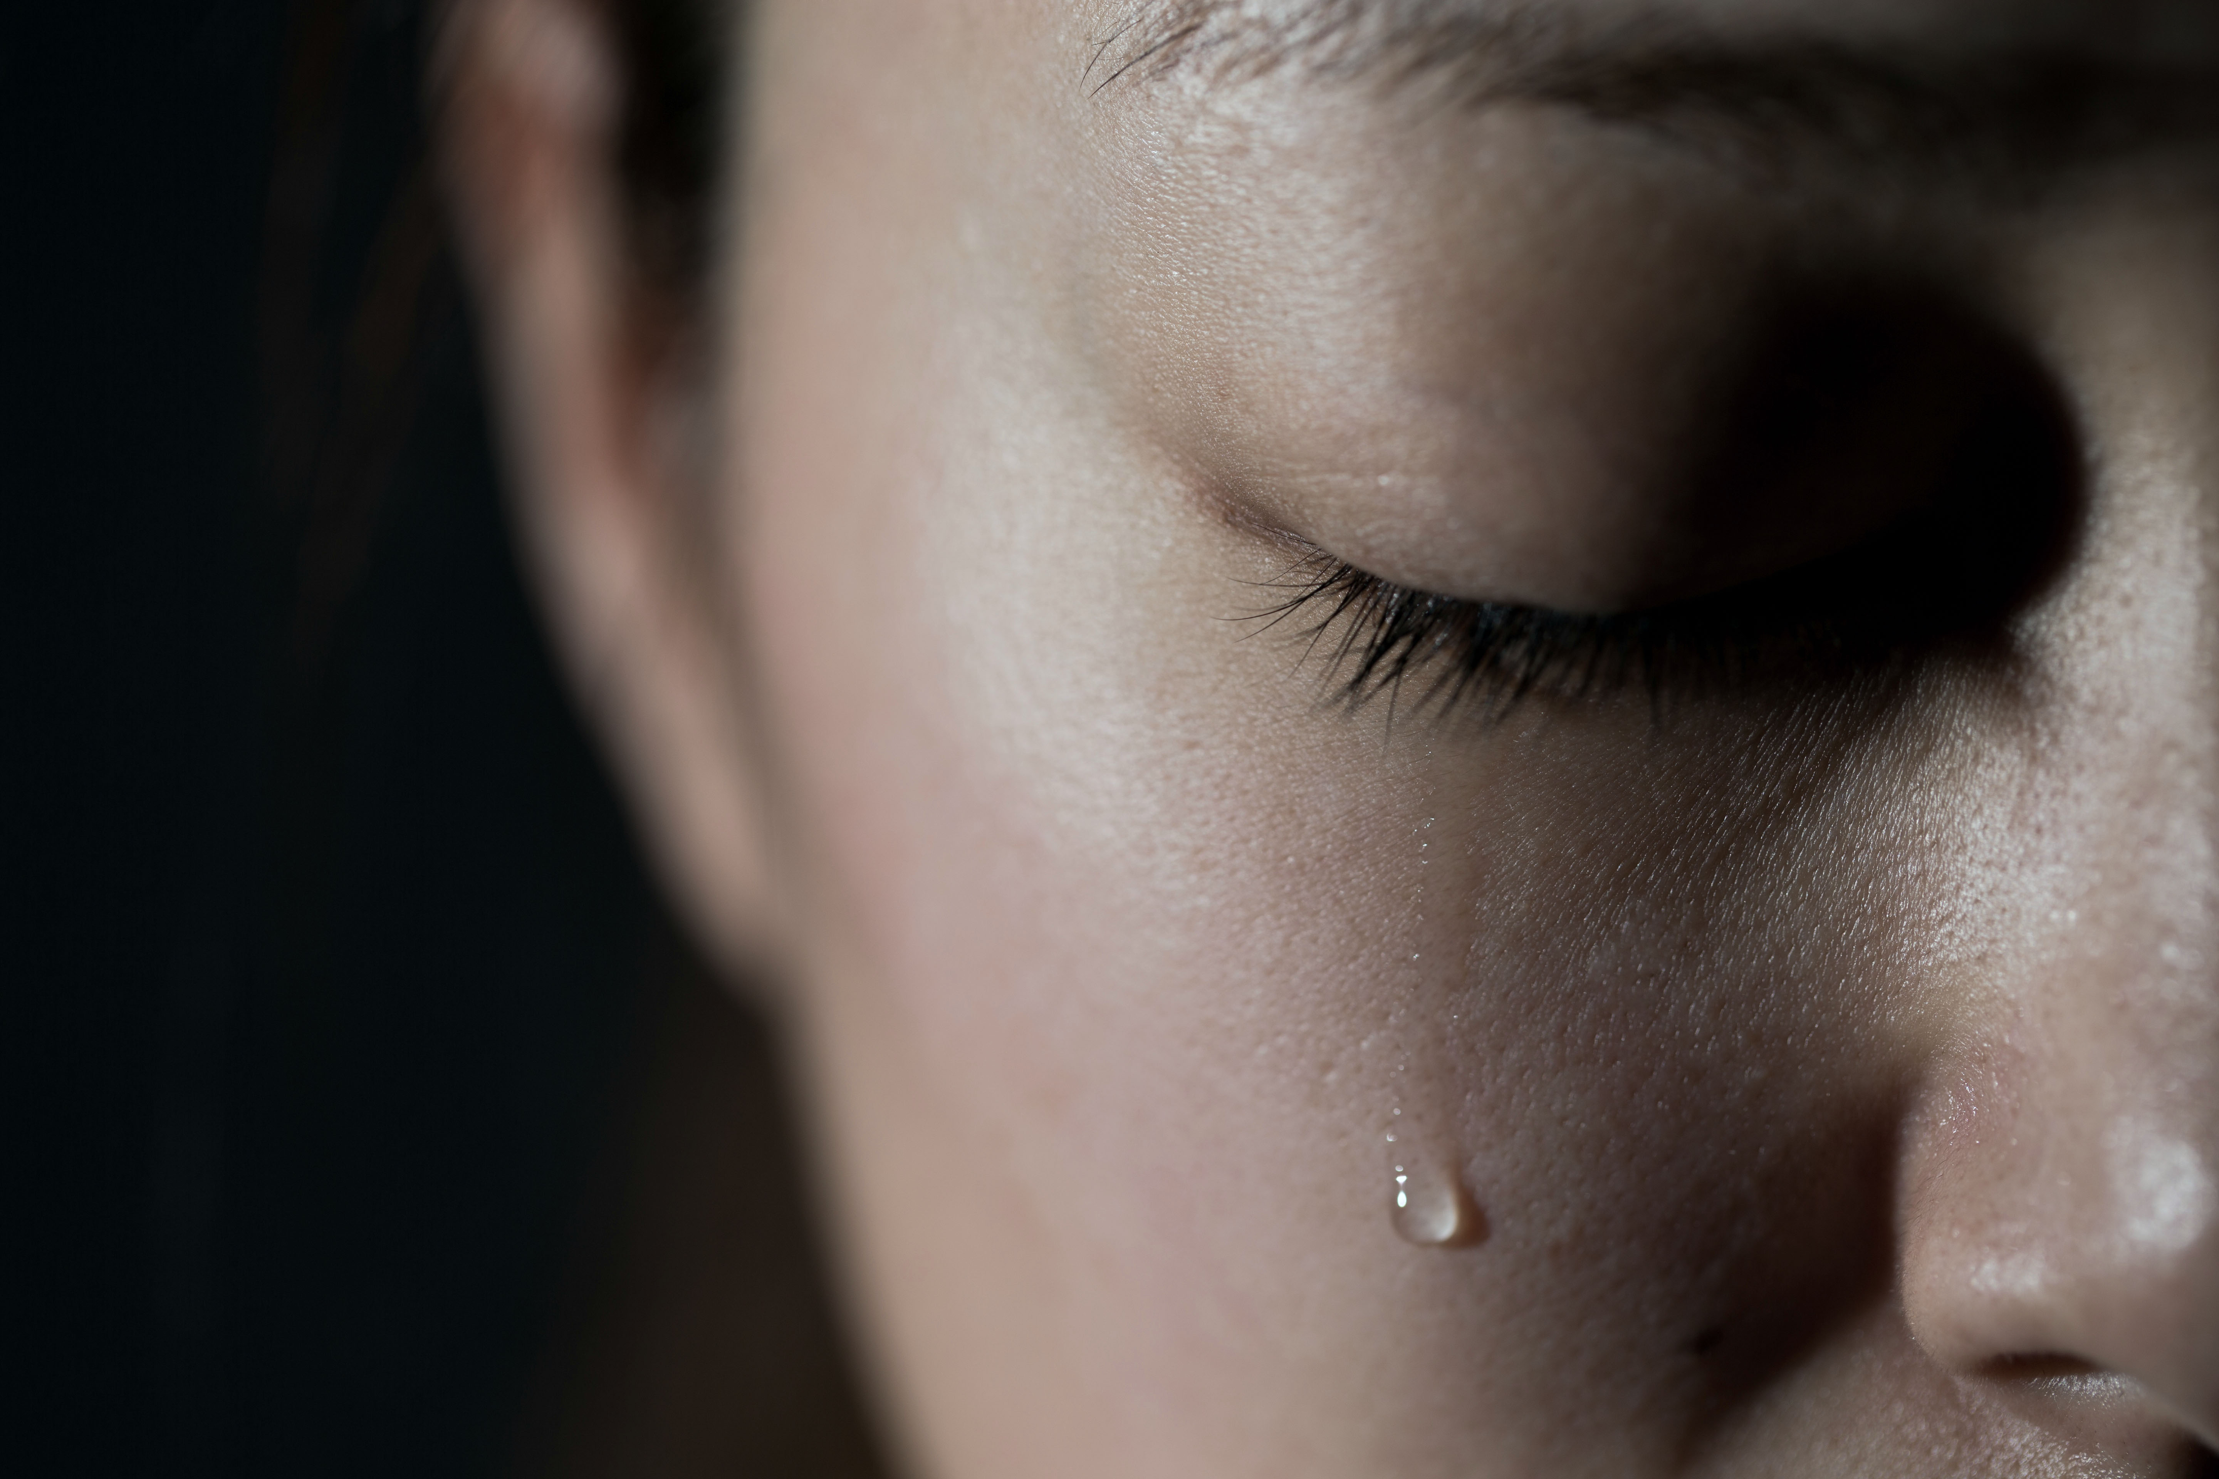
Emotional
Confronting the amputation
The aftermath emotions
Humor
Acceptance

Slide 5
Physical
Limitations
Pain
Devices
Therapy

Slide 6
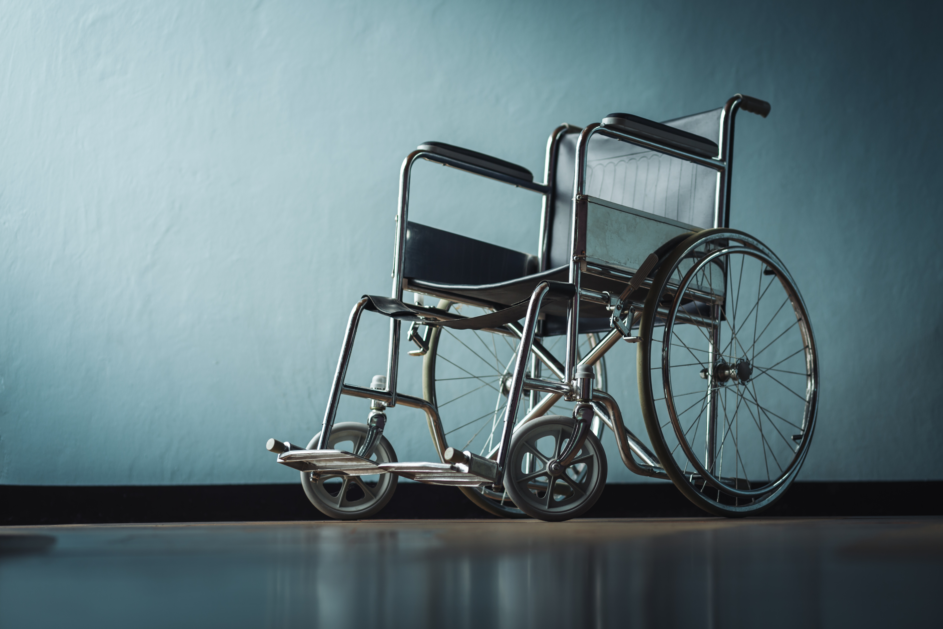
Devices
Wheelchair
Walker
Knee scooter
Crutches
Ramp

Slide 7
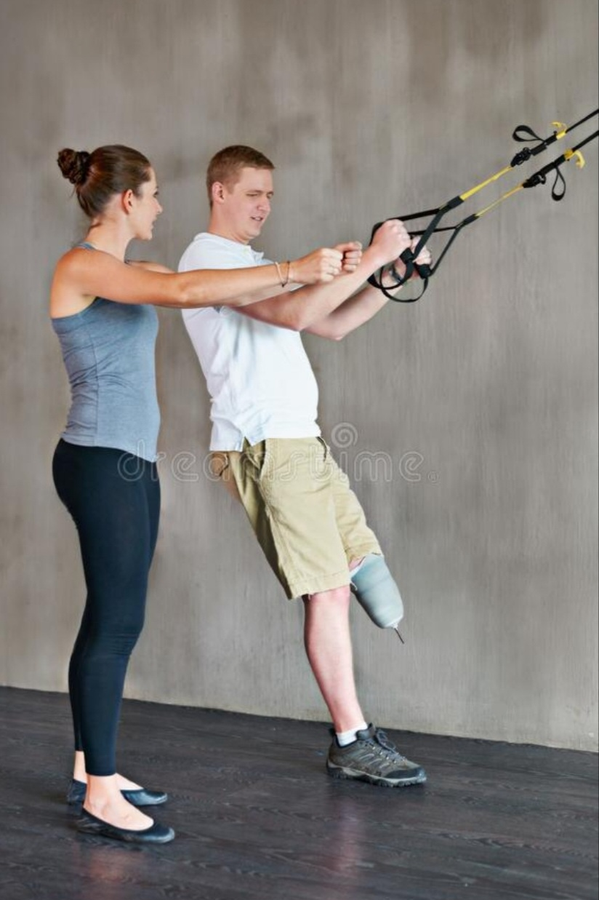
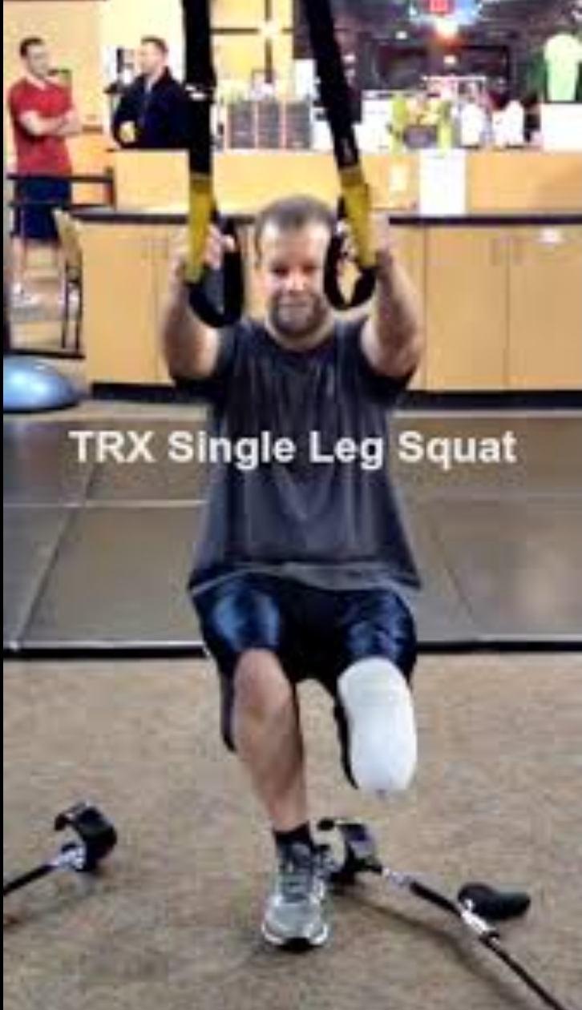
TRX
Born in 2005
Suspension system
Price ranges $35-$139

Slide 8
Social
New way of life concerns
Social interactions
Information

Slide 9
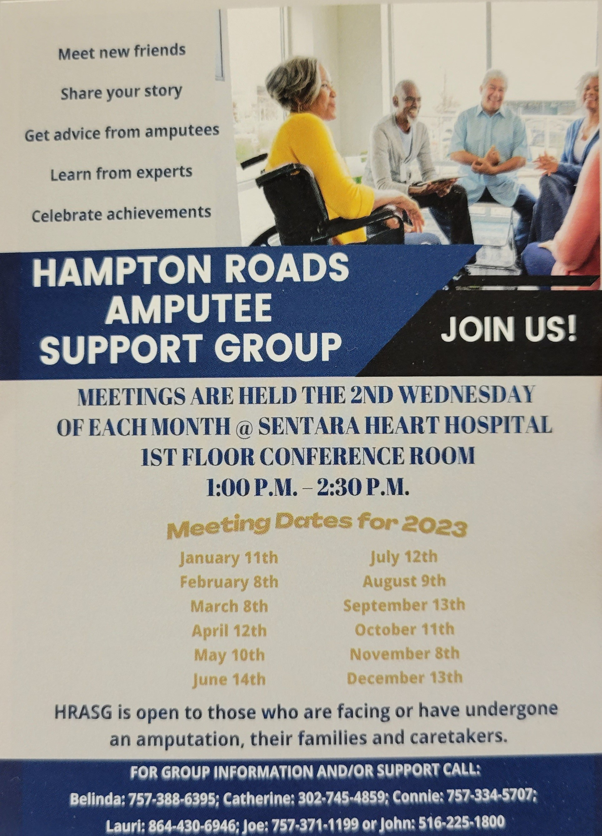
It Takes a Village
Amputation Clinic
Surgery representative
Social worker
Prosthetics
Physical therapy
Support Group
Other Resources
Notes:
I get by with a little help from my friends- The Beatles 1967, maybe not take all the lyrics to heart, but it does take a village to "raise" an amputee

Slide 10
Operation Ramp It Up
Launched in 2014
Originally just Vets
Volunteers all over the country
https://operationrampitup.com
Notes:
Stumbled across this project while listening to a national AM radio show
Started by a UPS driver in Ohio
Ramps are built within 4-6 hours
Includes all with mobility issues
As of Jan 2022 over 250 ramps installed or recycled in 39 states

Slide 11
Let's Get a Jump on the Ramp
"The Perfect World"
Confront the issue
Talk to the surgeon
Meet with Prosthetics
Start preparing environment

Slide 12
In Conclusion
Let's remember PREVENTION is key
Make the patient a part of the care team
Never hesitate to reach out or refer
Building the ramp early = better outcomes

Slide 13
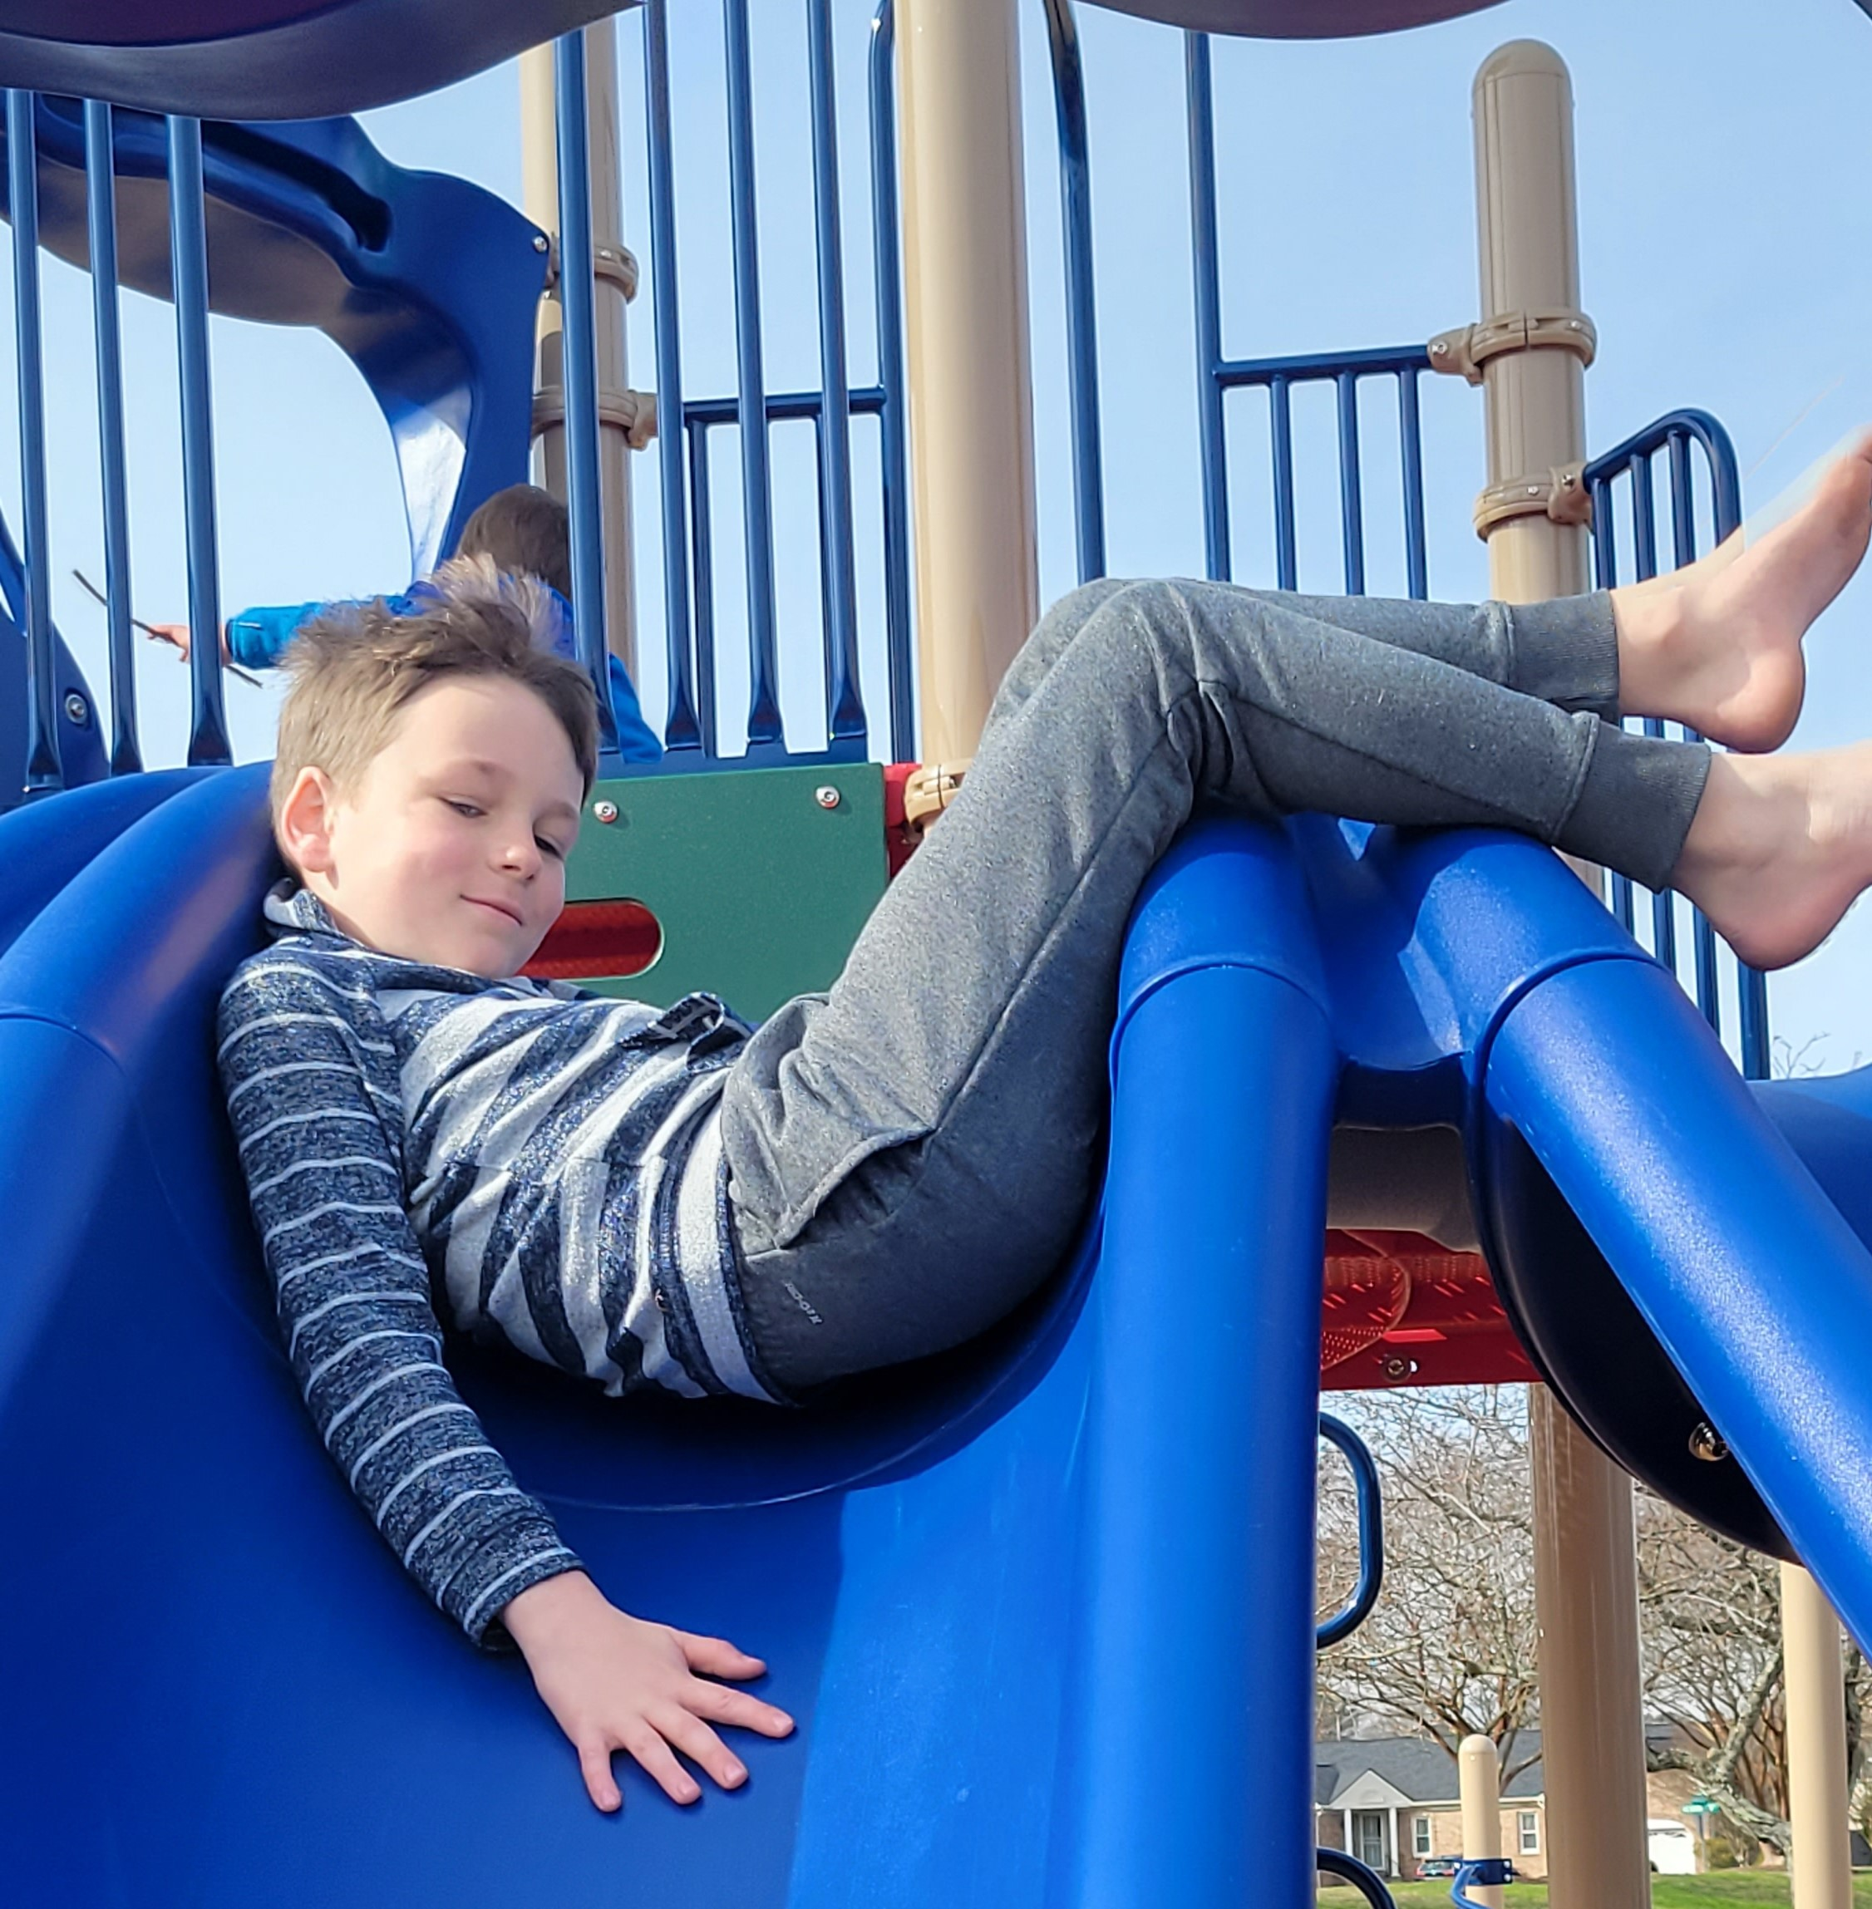
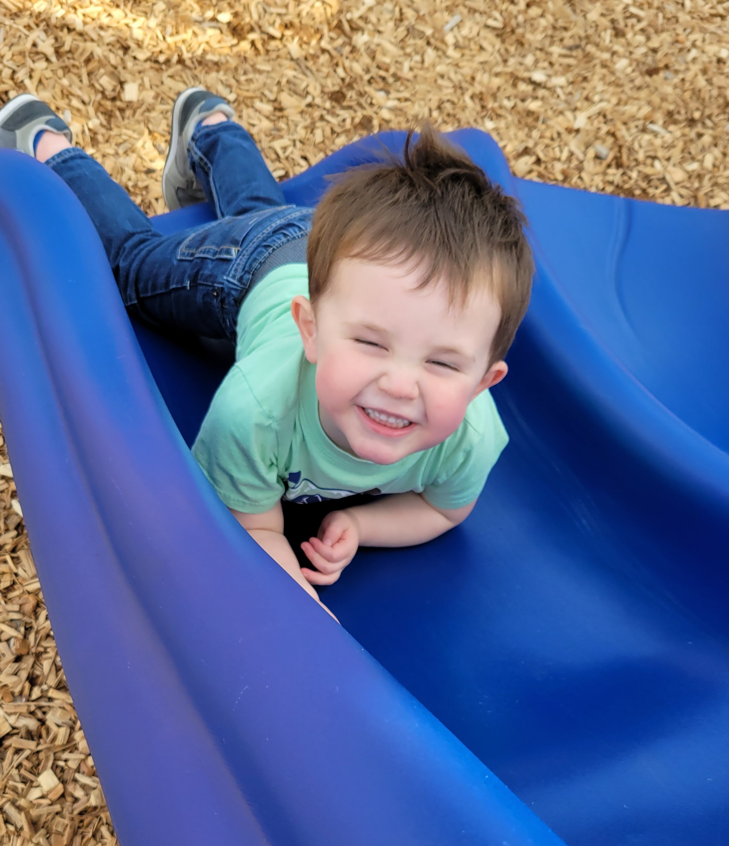
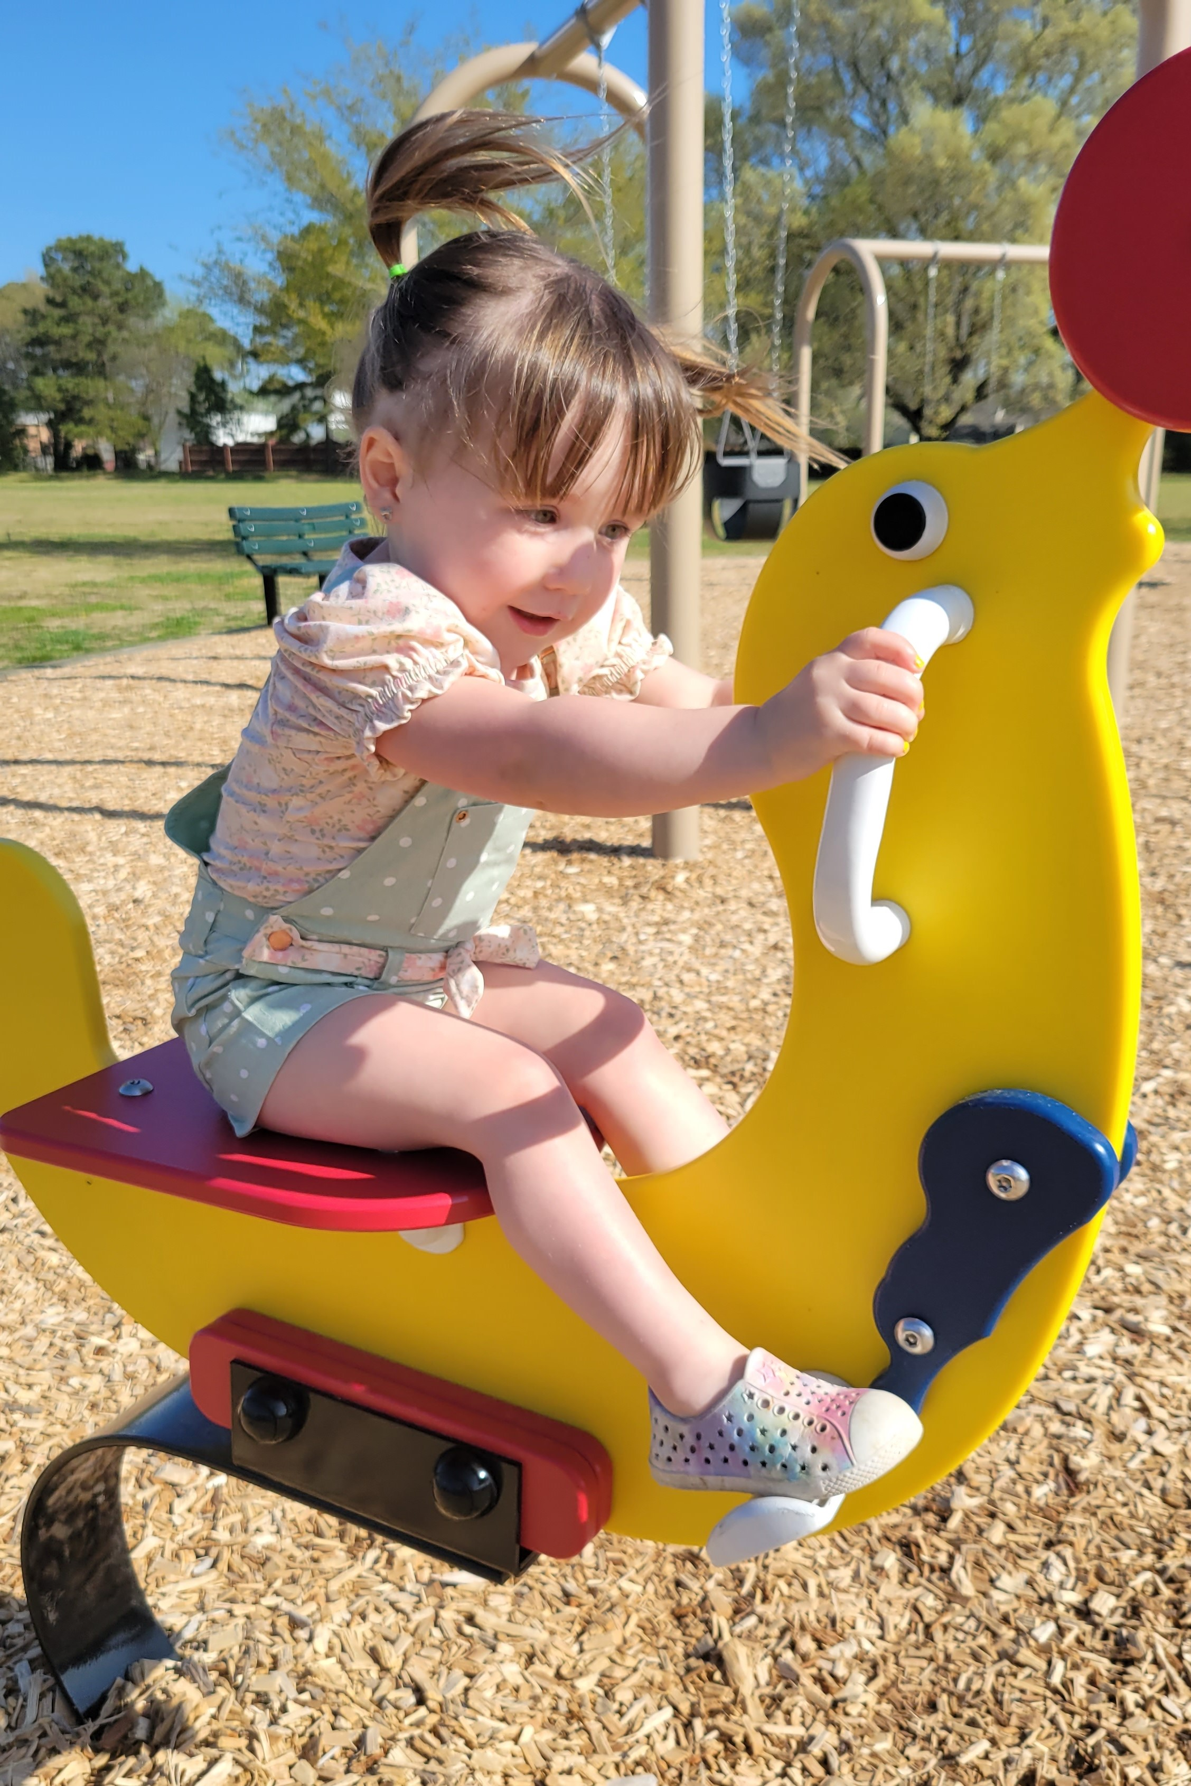
Thank you!!

